Slide 1
The Cool Code Consortium
7-12-2017
Notes:
Use this for Pro Audio Segments

Slide 2
Stuff
Cool News
LabVIEW
Next Week

Slide 3
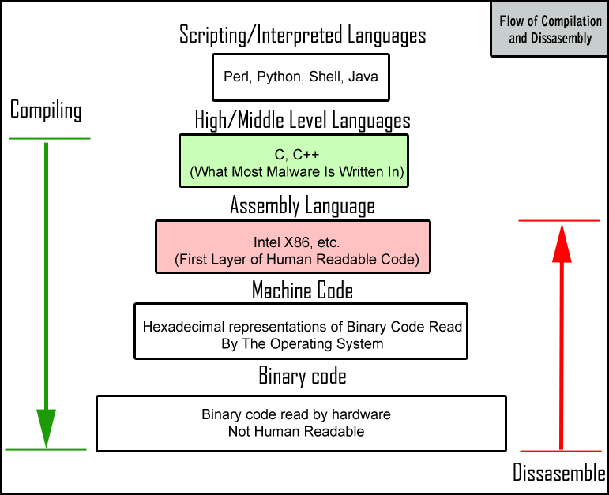

Slide 4
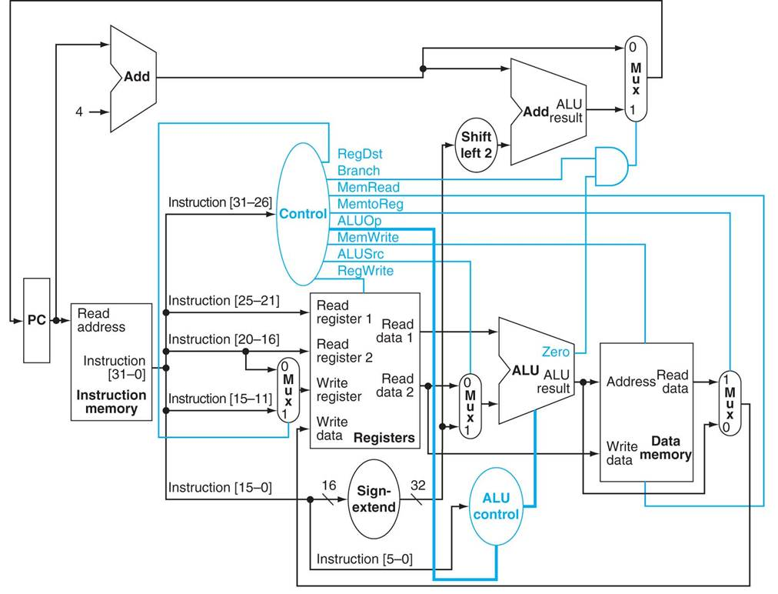

Slide 5
Cool News
https://www.theverge.com/2017/7/7/15938022/facebook-goolge-net-neutrality-protest-day-of-action-fcc
https://www.theverge.com/2017/7/7/15933516/apple-imagination-technologies-graphics-partner-short-notice-cutoff
https://www.wired.com/story/russian-hackers-attack-ukraine/

Slide 6
LabVIEW
http://prezi.com/mlln_rnmrjte/?utm_campaign=share&utm_medium=copy

